Slide 1

Notes:
Slide 1: Title Slide
Script: Hello everyone. My name is Ben Erickson, and I'll be presenting my research on EigenLayer. EigenLayer is a new Ethereum protocol that allows validators to restake their ETH to secure multiple services.

Slide 2

EigenLayer’s Restaking Model:
Expanding Capital Efficiency or Undermining Ethereum’s Security?
Benjamin Erickson | Spring 2025
Notes:
Slide 2: Paper Title Slide
Script: "My paper explores whether this innovation expands capital efficiency or introduces risks that could undermine Ethereum's security."

Slide 3
THESIS
EigenLayer dramatically improves capital efficiency but also introduces new systemic risks. However, with strong safeguards in place, these risks can be mitigated without undermining Ethereum’s core security.
EigenLayer
Restaking
Model
Notes:
Slide 3: Thesis Statement
Script: "My central thesis is that EigenLayer dramatically improves capital efficiency by letting validators reuse staked ETH across multiple services, which can significantly boost yields. But this also introduces new risks—like cascading slashing, validator concentration, and governance complexity—that could erode trust and stability. With strong safeguards in place, though, these risks can be mitigated without undermining Ethereum’s core security."

Slide 4

Ethereum
Proof-of-Stake Model
How does it work?
ETH validators lock 32 ETH (~$50K)
Modest 3–5% rewards
Capital is locked and can’t secure other protocols or be used elsewhere in DeFi (prior to LSTs)
Each new DApp must bootstrap its own validator set
Notes:
Slide 4: Ethereum’s Proof-of-Stake Model
Script: "Ethereum's PoS model requires validators to lock 32 ETH (worth approximately $50,000 as of today), which earns modest rewards of 3–5%. That ETH is locked—it can't be used elsewhere to secure other services or elsewhere in defi, which limits its productivity (unless LSTs are being used, ex Lido). And every new decentralized application or service must bootstrap its own validator set, which is capital-intensive and slows innovation."

Slide 5
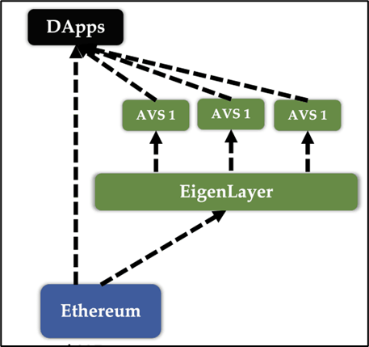
What is EigenLayer?
oracles, bridges, rollups
Restaking Middleware
Protocol
Middleware Layer
Notes:
Slide 5: What is EigenLayer?
Script: “EigenLayer changes this. It’s a middleware protocol that lets validators reuse — or restake — their ETH to secure new protocols, called AVSs. These include oracles, bridges, and rollups. Validators earn extra yield, and new protocols don’t have to build trust from scratch — they borrow Ethereum’s validator pool.”

Slide 6

Why Use EigenLayer (Even for Chainlink)?
Feature | Chainlink Only | EigenLayer Only | Combined Approach
Ethereum Usage | Finality only | Finality + Validator Enforcement | Finality + Enforcement
Validator Set | Own oracle nodes | Ethereum PoS Validators (via restaking) | LINK nodes + ETH validators
Slashing Support | LINK staking only | Slashing via ETH restaking | LINK + ETH slashing (dual enforcement)
Security Scaling | Capped by LINK stake | Scales with ETH restaked | Flexible and scalable based on TVL
Use Case Example | $1B LINK secures $100B in assets → risky | AVS can launch fast with ETH-backed trust | Chainlink supplements own security with ETH to protect high-value systems like DeFi and bridges.
Notes:
Slide 6: Why Use EigenLayer (Even for Chainlink)?
Script: “Take Chainlink — a popular oracle that already uses Ethereum to post data. But it secures that data with its own validator network, not Ethereum’s. EigenLayer allows Chainlink — or any AVS — to tap into Ethereum validators through restaking. They don’t have to give up their system — they can combine both. This is especially important for protocols securing billions in value — like $100B in DeFi — where extra layers of protection matter.”

Slide 7
How does it work?
ETH yield (3-5%) + AVS yields (~0.5-2% per AVS)
Slashing risk
Higher returns = higher exposure
EigenLayer Restaking Model
Notes:
Slide 7: Restaking Model – How Does It Work?
Script: “Restaking boosts validator income. You get your Ethereum base yield — 3 to 5% — plus an extra 0.5 to 2% per AVS. But here’s the trade-off: you take on more slashing risk. The more protocols you secure, the more ways you can get penalized.”

Slide 8
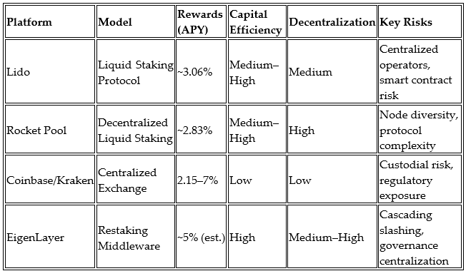
Analysis: Capital Efficiency vs Security Tradeoff
Notes:
Slide 8: Capital Efficiency vs. Security Tradeoff
Script: “This is where the trade-off becomes real. EigenLayer scores highest on capital efficiency compared to other staking models. But it also opens new attack surfaces. The more your ETH is reused, the more one failure can trigger others — that’s cascading slashing.”

Slide 9
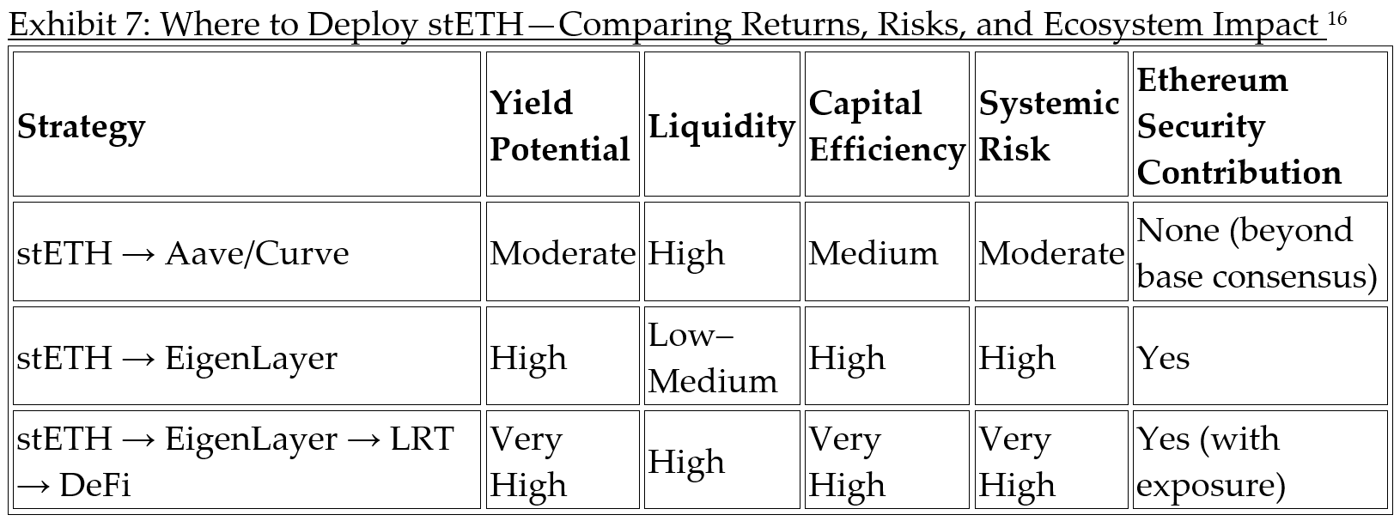
Analysis: Capital Efficiency vs Security Tradeoff
Notes:
Slide 9: stETH Strategy Comparison
Script: “This slide compares how stETH — Ethereum’s liquid staking token — can be used. DeFi platforms offer flexible yield. EigenLayer strengthens protocol security. Combine both, and you maximize yield — but you also take on stacked risk. It’s all about balance.”

Slide 10

Simulation Overview
Monte Carlo simulation
1,000 validators
Scenarios:
None
Single AVS failure
5 failures (cascade)
20 failures (panic)
Validator profiles: conservative to ultra-aggressive
Notes:
Slide 10: Simulation Overview
Script: “To model that risk, I built a Monte Carlo simulation of 1,000 validators over a year. Testing four scenarios — no AVS failure, one failure, five failures, and a full panic with 20 failures. Validators had different strategies — conservative to ultra-aggressive.”

Slide 11
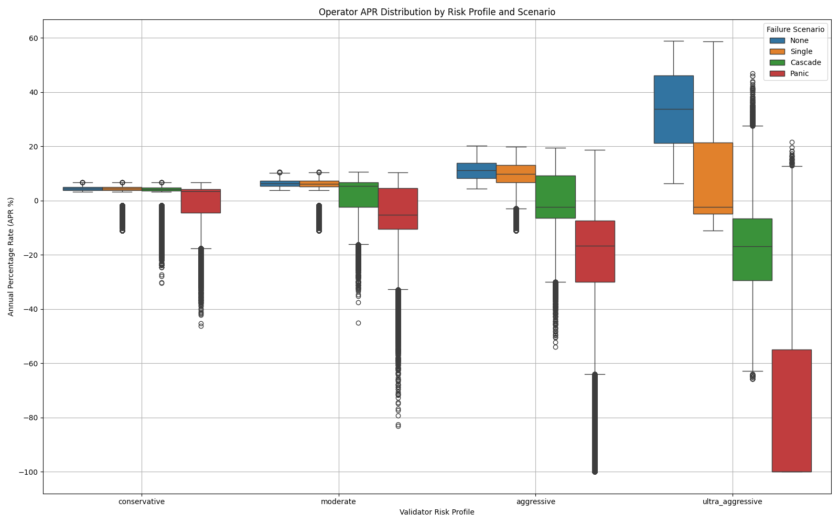
APR by Scenario and Risk Profile
Ultra-aggressive validators can lose up to 100%
Conservative validators stay mostly positive
Notes:
Slide 11: APR by Scenario and Risk Profile
Script: “These are the results of the simulation.
In the base case, high-risk validators perform best. But once AVSs start failing, their APRs drop fast.
Ultra-aggressive validators lose nearly everything in cascade and panic scenarios.
Conservative validators, on the other hand, stay mostly positive—even under stress.
So, the more AVSs you validate, the higher your potential returns—but the higher your slashing risk too."

Slide 12
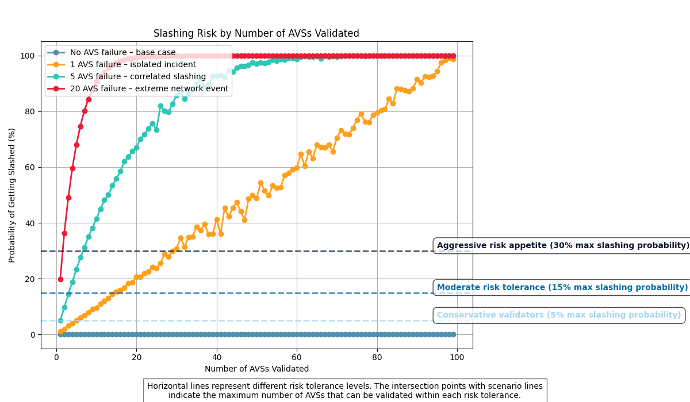
Slashing Risk
by
# of AVSs Validated
Notes:
Slide 12: Slashing Risk by # of AVSs Validated
Script: "This graph shows how that risk grows.
Slashing risk increases with more AVSs validated.
Each curve is a failure scenario—from isolated to panic.
Once you hit around 10 AVSs, slashing probability spikes—even for moderate and aggressive profiles.
That means validators need to set limits. For example:
Conservative = ~3 AVSs
Aggressive = ~10 max
This helps validators set exposure thresholds based on their risk appetite — something the protocol itself could help enforce. So managing AVS exposure is key to avoiding system-wide losses."

Slide 13

If the risks are too great:
Cascading Slashing
Validator Concentration
Governance Complexity
Overextended Collateral
The safeguards are not carefully integrated and enforced.
Addressing Thesis Limitations
Notes:
Slide 13: Addressing Thesis Limitations (Where My Thesis Could Be Wrong)
Script: “But what if the safeguards fail? Validators could be slashed across multiple AVSs — even for a single mistake. High yields might cause validator centralization. Governance could become complex and slow. And if restaked ETH is overused, failures could cascade as seen in traditional finance. That’s the risk.”

Slide 14

Safeguards & Proposals
Operator sets, Anti-slashers, EigenGov
AVS Risk Scoring
Decentralized Insurance Fund
Tiered Slashing
Governance Transparency Dashboard
Notes:
Slide 14: Safeguards & Proposals
Script: “EigenLayer already has tools like operator sets and EigenGov. But I propose four more: a risk scoring system for AVSs, a decentralized insurance fund to absorb slashing losses, tiered penalties based on severity, and a transparency dashboard so stakeholders understand how governance decisions are made.”

Slide 15
Conclusion
Restaking boosts efficiency, but creates risk.
Simulation supports thesis: smart limits = safe yield.
With safeguards, EigenLayer enhances capital efficiency without undermining security.
Notes:
Slide 15: Conclusion
Script: “Restaking is a powerful innovation. It makes Ethereum’s capital more productive by letting the same ETH secure multiple protocols.
But that efficiency comes with risk. Without limits, validators can overextend and destabilize the system they’re supposed to protect.
My simulation shows that with guardrails — like slashing thresholds, risk scoring, and clear governance — validators can earn more safely, and Ethereum’s security can scale.
So returning to the core question:
Can EigenLayer expand capital efficiency without undermining security?
The answer is yes — but only if the risks are understood, and the safeguards are enforced.”

Slide 16

THESIS
EigenLayer dramatically improves capital efficiency but also introduces new systemic risks. However, with proper safeguards in place, these risks can be managed without undermining Ethereum’s core security.
EigenLayer
Notes:
Slide 16: Q&A
Script: “Thanks for listening. I’m happy to take any questions.”

